Slide 1
Check-In/Check-Out (CICO)
Data Analysis
Juliana Levchenko, Ph.D.
School Mental Health Collaborative
November 2025
Notes:
Hi everyone, thanks for being here. Today I’ll be sharing the latest results from our ongoing analysis of the Check-In/Check-Out, or CICO, intervention.
This analysis looks at student outcomes collected between 2021 and 2025 and focuses on two types of data. The first is direct observation data, which captures what students are doing in the classroom. The second is teacher-rated data from the BASC-3, which reflects broader behavioral and emotional functioning.
These results inform both our upcoming manuscripts and how we support schools that implement CICO.

Slide 2
Project Overview
Goal: Estimate the impact of CICO on student engagement and behavior
Design: Students (Level 1) nested within teachers/classrooms (Level 2) and schools (Level 3)
Methods: Multi-level modeling of observational and rating data
Research Questions:
RQ1: Do students receiving CICO show higher on-task behavior and lower disruptive behavior over time compared to those in business-as-usual (BAU) conditions?
RQ2: Do CICO students exhibit better BASC-3 teacher-rated outcomes at posttest after controlling for baseline scores?
Notes:
Our goal with this evaluation was to understand how CICO influences student engagement and behavior.
The design accounts for students nested within teachers and schools, so it uses multilevel models to properly handle that structure.
We looked at two research questions.
First, do students in CICO show higher on-task behavior and lower disruptive behavior over time compared to students in the business-as-usual group?
And second, do CICO students have better posttest teacher-rated outcomes on the BASC-3 after controlling for their baseline scores?
Together, these questions give us a clear picture of both short-term and longer-term changes.

Slide 3
Data Sources & Outcomes
Data Sources:
CICO Direct Observations (SDO): 2021–2025 repeated classroom observations of target students
BASC-3 Teacher Ratings: Collected pre- and post-intervention
Linked identifiers: Students, teachers, and schools
Key Outcomes:
Proximal (SDO): Percent on-task and percent disruptive
Distal (BASC-3): Externalizing, Internalizing, School Problems, and Adaptive Skills
Notes:
We drew from two main data sources. The first is the CICO direct observation data, collected from 2021 through 2025. The second is teacher-rated BASC-3 data, collected at pretest and posttest.
Each dataset is linked by student, teacher, and school IDs so that we can connect observations and ratings within the same classroom context.
For outcomes, the SDO data capture percent on-task and percent disruptive, while the BASC-3 data include Externalizing, Internalizing, School Problems, and Adaptive Skills.
One note about Adaptive Skills: that scale is reverse-coded, so higher scores mean stronger adaptive functioning. When we look at lower scores later, that doesn’t mean worse behavior. It means fewer adaptive behaviors as reported by the teacher.

Slide 4
Analysis Workflow
Import, merge, and clean multi-year SDO and BASC-3 datasets
Address missingness with full-information maximum likelihood (FIML)
Test baseline equivalence and differential attrition across groups
Fit multilevel models:
  RQ1: 3-level growth models (time within students within schools)
  RQ2: 2-level ANCOVA models (students within classrooms)
Compare fixed vs. random school effects for model fit and interpretability
Estimate adjusted means, intraclass correlations (ICCs), and standardized effect sizes
Notes:
We started by cleaning and merging the multi-year data and then handled missing data using full-information maximum likelihood, which allows us to use all available data points.
We tested for baseline equivalence and checked attrition rates before modeling.
For the modeling itself, we used three-level growth models for the SDO data, with time nested within students and students nested within schools. For the BASC-3, we used two-level ANCOVA models with students nested within classrooms.
We compared fixed and random school effects and found that models with fixed effects generally fit better.
Finally, we reported adjusted means, intraclass correlations, and standardized effect sizes to make the results interpretable and comparable across measures.

Slide 5
Data Summary
SDO: 1,153 total phase-level observations, 326 unique students across 24 schools
BASC-3: 249 students across 149 teachers
Differential attrition (SDO): CICO 6.8%, BAU 0.7%, p = .017
Attrition included as a covariate in SDO models
BASC attrition low and balanced across groups(p = .94)
Notes:
For SDO data, we had a total of about 1,150 phase-level observations across 326 students in 24 schools.
For BASC-3 data, we has 249 students across 149 classrooms.
Attrition was slightly higher in the CICO group at about 6.8 percent, compared to less than one percent for the business-as-usual group. This difference was statistically significant, so we included an attrition covariate in the SDO models to account for that.
For the BASC-3 data, attrition was low overall and not significantly different across conditions.

Slide 6
RQ1: Baseline & ICCs
Baseline Equivalence:
Groups were similar at baseline
  On-task: g = 0.12
  Disruptive: g = 0.11
Intraclass Correlations (ICCs):
On-task = .49
Disruptive = .60
→ Strong clustering; multilevel modeling appropriate
Notes:
Before running the main models, we checked whether the two groups looked similar at baseline.
The results showed that they did: CICO and BAU students had nearly identical on-task and disruptive behavior before the intervention started.
We also calculated intraclass correlations, or ICCs, to see how much variation came from classrooms and schools.
The ICCs were fairly high: about 0.49 for on-task and 0.60 for disruptive behavior, which tells us that a lot of the differences in behavior were related to classroom or school context. That’s why multilevel modeling is used.

Slide 7
RQ1: Multilevel Growth Results
At Posttest (Week 12):
CICO students more on-task (b = 0.13, p = .001)
CICO students less disruptive (b = –0.16, p < .001)
Growth Over Time (Week × Condition):
On-task increased faster for CICO (b = 0.005, p = .001)
Disruptive behavior declined faster (b = –0.003, p = .010)
Model Fit:
Fixed school effects fit better than random (ΔAIC ≈ 20–50)
Notes:
By posttest, students in CICO were significantly more on-task and less disruptive than those in the BAU group.
Specifically, on-task behavior increased by about 13 percentage points, and disruptive behavior decreased by about 16 points.
The interaction between week and condition showed that CICO students improved faster over time, suggesting strong intervention effects.
When we compared model structures, the fixed school effects provided a better fit than random effects, meaning the differences between schools were systematic and best modeled individually.

Slide 8
RQ1: Standardized Effects by Phase
Phase | On-Task (d) | Disruptive (d)
Baseline | –0.07 | 0.07
Mid | 0.04 | –0.01
Post | 0.26 | –0.17
Maintenance | 0.37 | –0.25
Interpretation:
CICO students became more engaged and less disruptive by posttest
Gains continued or strengthened during maintenance
Notes:
Here you can see the standardized effect sizes for each phase.
At baseline, the groups were similar, but by posttest, we saw moderate effects favoring CICO: about 0.26 for on-task and –0.17 for disruptive behavior.
By the maintenance phase, the effects grew even larger, with on-task reaching 0.37 and disruptive behavior dropping to –0.25.
This pattern shows that gains were not only maintained but strengthened over time, which suggests that students continued to use the skills they developed during CICO even after intervention ended.

Slide 9
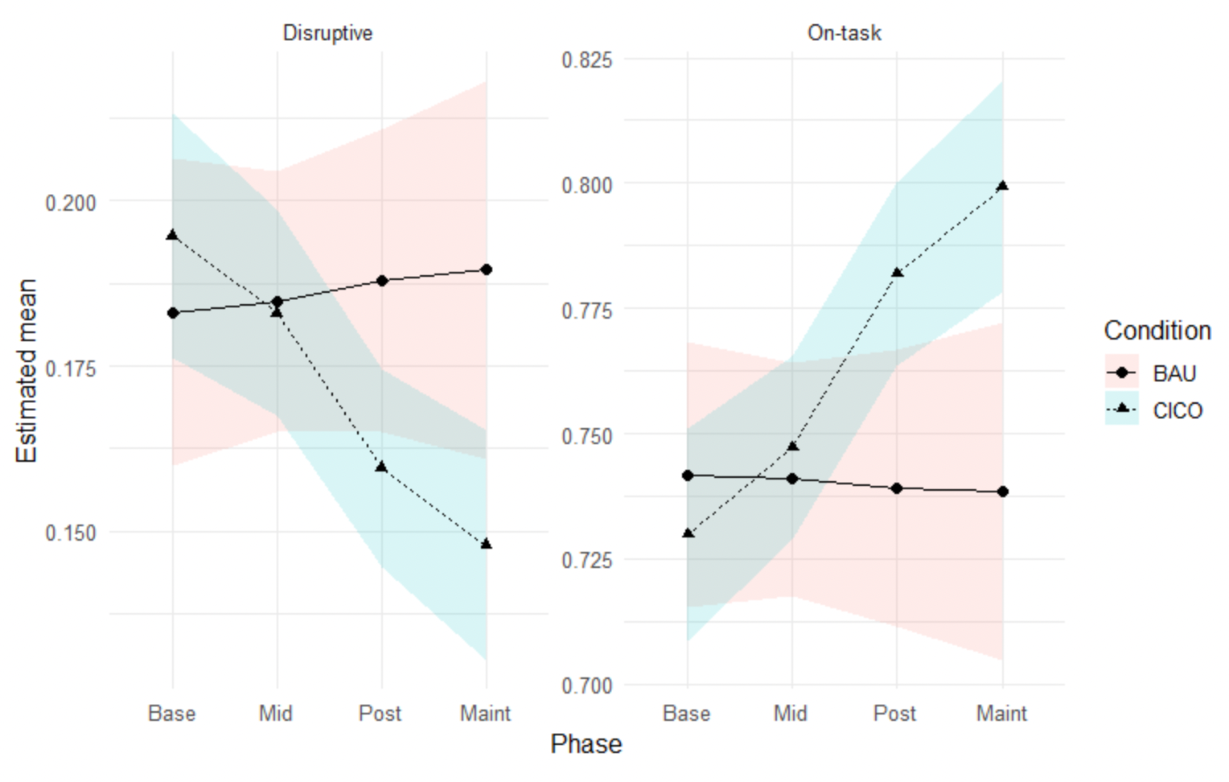
Change in On-Task and Disruptive Behavior Over Time
CICO students became more on-task and less disruptive across phases
BAU students showed little or no change over time
Group differences became most pronounced by Post and Maintenance phases
For on-task behavior, CIs showed minimal overlap at Post and no overlap at Maintenance, indicating a statistically significant difference
Notes:
This figure shows how student behavior changed over time for the CICO and BAU groups.
Students who received CICO became progressively more on-task and less disruptive across each phase, while students in the BAU group showed little or no change.
The two groups started out at similar levels during baseline and mid-intervention.
For on-task behavior, the confidence intervals begin to separate noticeably at the post phase and show no overlap during maintenance, indicating a statistically significant difference.

Slide 10
RQ2: BASC-3 Preliminary Checks
Baseline Equivalence: Small differences (g = –0.02 to –0.16)
Attrition: Low (~6.6%) and balanced (p = .94)
ICCs:
Externalizing = .43
Internalizing = .47
Adaptive Skills = .32
School Problems ≈ 0
→ Supports two-level ANCOVA (students in classrooms)
Notes:
Before running the BASC-3 models, we again checked baseline balance, attrition, and ICCs.
The two groups were balanced at baseline across all four scales, and attrition was minimal and not different between conditions.
ICCs ranged from about 0.3 to 0.5, which supports using multilevel modeling to account for classroom effects.
For School Problems, the ICC was near zero, which later caused a boundary or singular warning in the model output. That warning just means there was almost no classroom-level variance to estimate, not that the model failed.

Slide 11
RQ2: Adjusted Posttest Means
Scale | BAU | CICO | p | Cohen’s d
Externalizing | 68.1 | 62.7 | < .001 | –0.46
Internalizing | 59.7 | 55.8 | .006 | –0.27
School Problems | 61.8 | 58.6 | < .001 | –0.35
Adaptive Skills | 45.5 | 42.9 | .001 | –0.38
Notes:
After controlling for baseline, CICO students had significantly lower scores on Externalizing, Internalizing, and School Problems compared to BAU students.
Lower scores on these scales mean fewer problem behaviors and emotional difficulties.
Effect sizes ranged from about –0.27 to –0.46, which are moderate effects for behavioral interventions.
Adaptive Skills were also lower for CICO students, but because that scale runs in the opposite direction, this finding likely reflects how teachers rated adaptive functioning rather than a true decline. It’s something we’ll continue to look into.

Slide 12
RQ2: Interpretation
CICO students showed lower externalizing, internalizing, and school problem scores
Adaptive Skills were also lower, which needs contextual discussion (lower ≠ better)
ICCs (0.23–0.33) confirmed moderate classroom clustering
School Problems ICC ≈ 0 explained singularity warnings (negligible classroom variance)
Notes:
Across all BASC-3 outcomes, CICO produced significant improvements in teacher-rated behavior.
The differences on Adaptive Skills probably reflect context or perception rather than a negative change.
We saw boundary warnings in the School Problems model, but again, that was due to near-zero classroom variance, not an issue with the estimation.
ICCs were moderate, confirming that the two-level model was appropriate.

Slide 13
Key Takeaways
CICO students were more on-task and less disruptive by posttest
Effects persisted or grew during maintenance
Teacher-reported behavior (BASC-3) also improved significantly
Models supported fixed school effects and multilevel structure
Notes:
To summarize, CICO students were more on-task and less disruptive by posttest, and these improvements continued or even grew at maintenance.
Teacher ratings confirmed reductions in problem behaviors and emotional difficulties.
Models with fixed school effects consistently provided the best fit, showing that differences between schools were meaningful and not random.
Thanks! I’m happy to take any questions.

